Slide 1
MQTT topics assignment proposal
Giammarco Valenti, Francesco Biral, UNITN

Slide 2
MQuicklyTT
MQTT is a publish/subscribe communication protocol
Messages are organized in topics
Actors are:
Clients: which can subscribe to a topic or publish on a topic
The broker: the role of the broker is to manage those topics
Topics are strings, representing paths like folders, pointing to the payload
If a client is subscribed to a topic it will execute a callback every time a message is updated from another client
Here we have to decide How to define the topics

Slide 3
First proposal ( preferred ) –> V2X message to C-struct
Generate topics dynamically with IDs (from the signal maps) in the following order:
SafeStrip/<V2X message frame>/<station + ID>/payload
Examples (CAM):
Examples any other non v2x:
SafeStrip/CAM/vehicle_2/#
SafeStrip/CAM_2/#
SafeStrip/Non_v2x_container_1/#
Example (DENM):
SafeStrip/DENM_2/#

Slide 4
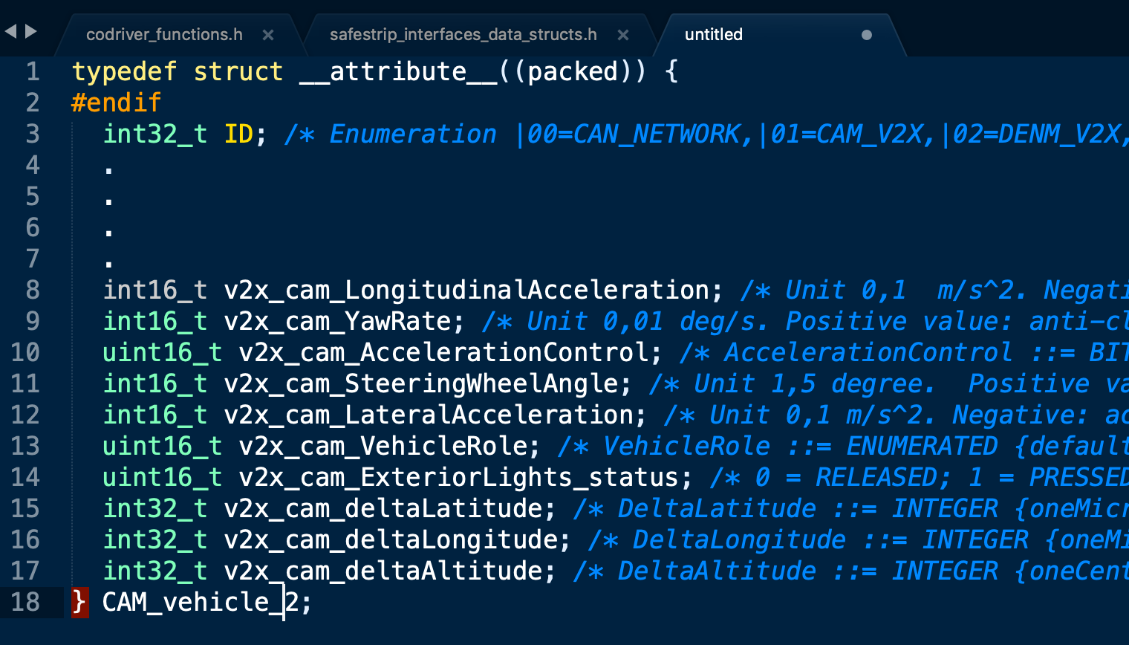
First proposal –> V2X message to C-struct Payload
Payload will be a serialized C-Struct, which fields are the signalMap entries
Example (CAM)→
In the application every message is a struct corresponding to a message frame

Slide 5
How to serialize C-structs on different machines?
Serializer code (c/c++) will be provided by UNITN in January (it is developed for other applications and it need some modifications only)
The serializer must be the same for all
Signal map must be the same as well for all
For non-v2x signals we can decide how to divide them, typically I expect a struct output for each app for example

Slide 6
Pros Cons
MQTT would work as the V2x (one topic= one message)
Cleaner structures
One update for message instead of one field
For non-v2x signals we can decide how to divide them
Few topics to manage in applications
Dynamic change of number of messages is easy to manage
Serializer code must be the same and compiled on each machine
Can the broker manage corrupted messages?
How to deal with Android phones?

Slide 7
Second proposal –> One topic for each signalmap entry
Generate topics dynamically with IDs (from the signal maps) in the following order:
SafeStrip/<V2X message frame>/<station + ID>/<signalmap_entry>/payload(array)
Examples (CAM):
SafeStrip/CAM/vehicle_2/longitudinal_acceleration/payload
Example (DENM):
SafeStrip/DENM_2/cause_code/payload

Slide 8
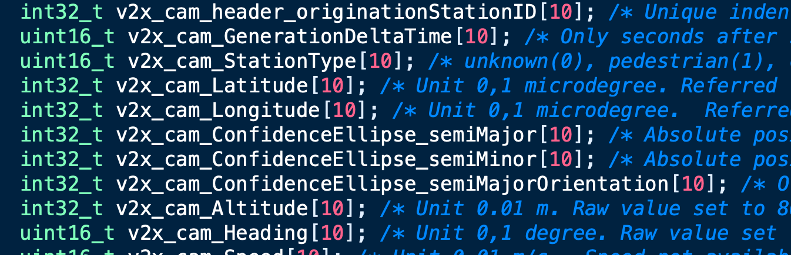
Second proposal –> One topic for each signalmap entry. Payload
Rigid arrays as payload
Number of the CAM/DENM is the index of the array
Example CAM:

Slide 9
How to serialize arrays on different machines?
Serializer code will be simpler but it has to be developed
The serializer must be the same for all
Signal map must be the same as well for all

Slide 10
Pros Cons
Easier to serialize
Shorter messages to fill
Easier debug of single message and corrupted messages
Fixed length of payload disregarding number of effective messages
Cam / Denm must be reassempled in the application domain
Every entry of array must be associated with an ID
If CAM are asynchronous, arrays may be only partially updated (!)

Slide 11
Questions
May “One topic for each single dataframe” be an option? May it lead to too many topics?
What are the message inspection capability of the broker?
Denm aside for the friction?
Channel DSS-HMI?

